Slide 1
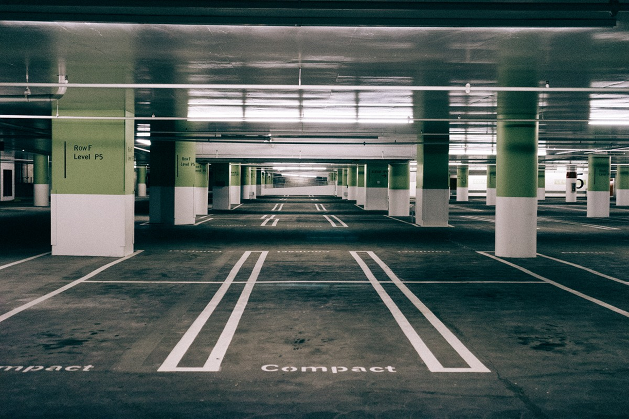
Smart Parking System

Slide 2

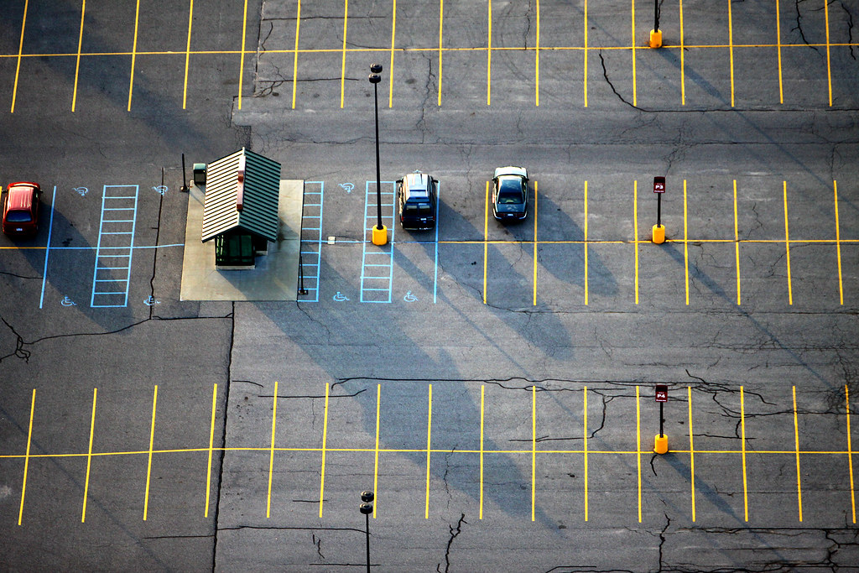









Slide 3
WHO ARE WE
Gamze Miray Aydemir/222010020056
Baturalp Ömer Dilber/222010020110
Mehmet Eren Tarhan/222010020126
Fikret Onat Barın/222010020128
Roles of the group members in the project
Gamze Miray Aydemir
The results are being consolidated, and the overall draft of the report is being prepared to ensure a cohesive and comprehensive presentation.
Baturalp Ömer Dilber
Identified shortcomings in the report and made necessary adjustments to ensure completeness and structure.
Mehmet Eren Tarhan
The circuit schematics and simulations are being simplified with creativity, effectively eliminating potential confusion and improving design clarity.
Fikret Onat Barın
The foundation for the circuit designs and simulations was established, demonstrating a solid understanding of the underlying principles. Additionally, Verilog code was authored to contribute significantly to the project's digital design and functionality

Slide 4
WHO ARE WE
Gamze Miray Aydemir/222010020056
Baturalp Ömer Dilber/222010020110
Mehmet Eren Tarhan/222010020126
Fikret Onat Barın/222010020128
Roles of the group members in the project
Gamze Miray Aydemir
The results are being consolidated, and the overall draft of the report is being prepared to ensure a cohesive and comprehensive presentation.
Baturalp Ömer Dilber
Identified shortcomings in the report and made necessary adjustments to ensure completeness and structure.
Mehmet Eren Tarhan
The circuit schematics and simulations are being simplified with creativity, effectively eliminating potential confusion and improving design clarity.
Fikret Onat Barın
The foundation for the circuit designs and simulations was established, demonstrating a solid understanding of the underlying principles. Additionally, Verilog code was authored to contribute significantly to the project's digital design and functionality
Why Did We Design This Circuit?
Solution to Parking Problems: With increasing urbanization and the rising number of vehicles, finding parking spaces, especially in large cities, has become a significant challenge. This system aims to reduce the time spent searching for parking spots and make the process more efficient.
Smart Cities: Our goal was to develop a technology-driven solution that aligns with the concept of smart cities, integrating innovation into everyday urban challenges.
Application AreasShopping Malls and Parking Garages: It can be used to optimize parking spaces in large shopping malls or indoor parking facilities.Airports and Train Stations: An ideal system for providing fast and efficient parking management in high-traffic areas.
Urban Parking Areas: It can be utilized for managing open or closed parking spaces within city centers as part of smart city projects.

Slide 5
Why Did We Design This Circuit?
Solution to Parking Problems: With increasing urbanization and the rising number of vehicles, finding parking spaces, especially in large cities, has become a significant challenge. This system aims to reduce the time spent searching for parking spots and make the process more efficient.
Smart Cities: Our goal was to develop a technology-driven solution that aligns with the concept of smart cities, integrating innovation into everyday urban challenges.
Application Areas Shopping Malls and Parking Garages: It can be used to optimize parking spaces in
large shopping malls or indoor parking facilities. Airports and Train Stations: An ideal system for providing fast and efficient parking management in high-traffic areas.
Urban Parking Areas: It can be utilized for managing open or closed parking spaces within city centers as part of smart city projects.

Slide 6
VERİLOG
output reg R_led0,// 1. LED kırmızı çıkışı
output reg R_led1,// 2. LED kırmızı çıkışı
output reg R_led2,// 3. LED kırmızı çıkışı
output reg R_led3,// 4. LED kırmızı çıkışı
output reg S_led0,//1. sarı çıkışı
output reg S_led1,//2. sarı çıkışı
output reg S_led2,//3. sarı çıkışı
output reg S_led3,//4. sarı çıkışı
//içeride olan araçsayısı ve yerleri
output reg KS_led0,//1, garaj
output reg KS_led1,//2. garaj
output reg KS_led2,//3. garaj
output reg KS_led3,//4. garaj
//içeride boş olan yerler ve yerleri
output reg YS_led0,//1.garaj
output reg YS_led1,//2.garaj
output reg YS_led2,//3. garaj
output reg YS_led3,//4. garaj
`timescale 1ns / 1ps
module verilog1(
// OTOPARK SWITCH
input wire switch0,// 1. switch
input wire switch1,// 2. switch
input wire switch2,// 3. switch
input wire switch3,// 4. switch
// REZERVE SWİTCH
input wire R_switch0,// 1. rezerve switch
input wire R_switch1,// 2. rezerve switch
input wire R_switch2,// 3. rezerve switch
input wire R_switch3,// 4. rezerve switch
output reg Y_led0,// 1. LED yeşil çıkışı
output reg Y_led1,// 2. LED yeşil çıkışı
output reg Y_led2,// 3. LED yeşil çıkışı
output reg Y_led3,// 4. LED yeşil çıkışı

Slide 7
VERİLOG
output reg R_led0,// 1. LED kırmızı çıkışı
output reg R_led1,// 2. LED kırmızı çıkışı
output reg R_led2,// 3. LED kırmızı çıkışı
output reg R_led3,// 4. LED kırmızı çıkışı
output reg S_led0,//1. sarı çıkışı
output reg S_led1,//2. sarı çıkışı
output reg S_led2,//3. sarı çıkışı
output reg S_led3,//4. sarı çıkışı
//içeride olan araçsayısı ve yerleri
output reg KS_led0,//1, garaj
output reg KS_led1,//2. garaj
output reg KS_led2,//3. garaj
output reg KS_led3,//4. garaj
//içeride boş olan yerler ve yerleri
output reg YS_led0,//1.garaj
output reg YS_led1,//2.garaj
output reg YS_led2,//3. garaj
output reg YS_led3,//4. garaj
`timescale 1ns / 1ps
module verilog1(
// OTOPARK SWITCH
input wire switch0,// 1. switch
input wire switch1,// 2. switch
input wire switch2,// 3. switch
input wire switch3,// 4. switch
// REZERVE SWİTCH
input wire R_switch0,// 1. rezerve switch
input wire R_switch1,// 2. rezerve switch
input wire R_switch2,// 3. rezerve switch
input wire R_switch3,// 4. rezerve switch
output reg Y_led0,// 1. LED yeşil çıkışı
output reg Y_led1,// 2. LED yeşil çıkışı
output reg Y_led2,// 3. LED yeşil çıkışı
output reg Y_led3,// 4. LED yeşil çıkışı
//REZERVE LED'LEDLERİN GÖSTERİM LEDLERİ
output reg Rez_led0,//1. rezerve LED
output reg Rez_led1,//2. rezerve LED
output reg Rez_led2,//3. rezerve LED
output reg Rez_led3,//4. rezerve LED
input wire D_switch0,//Dışarı kapı switch DIŞARI
input wire D_switch1,//İçer kapı switch DIŞARI
//=====================================>
output reg D_Y_led0,//1. LED yeşil çıkışı DIŞARI
output reg D_Y_led1,//2. Led yeşil çıkışı DIŞARI
//=====================================>
output reg D_R_led0,//1. LED kırmızı çıkışı DIŞARI
output reg D_R_led1//2. LED kırmızı çıkışı DIŞARI
//=====================================>
);
//Normal Garajların Çalışması
//GARAJ1
always@(switch0,switch1,switch2,switch3,R_switch0,R_switch1,
R_switch2,R_switch3)begin
R_led0 = ((switch0 |switch0)& ~R_switch0);//Kırmızı LED (İÇERİDE)
Y_led0 = ~switch0 & ~R_switch0;// Yeşil LED (GARAJ BOŞ)
S_led0 = ~(~R_switch0);// Sarı LED (REZERVE)
//GARAJ 2 İÇİN
R_led1 = ((switch1 |switch1)& ~R_switch1);//Kırmızı LED (İÇERİDE)
Y_led1 = ~switch1 & ~R_switch1;// Yeşil LED (GARAJ BOŞ)
S_led1 = ~(~R_switch1);// Sarı LED (REZERVE)

Slide 8
VERİLOG
//REZERVE LED'LEDLERİN GÖSTERİM LEDLERİ
output reg Rez_led0,//1. rezerve LED
output reg Rez_led1,//2. rezerve LED
output reg Rez_led2,//3. rezerve LED
output reg Rez_led3,//4. rezerve LED
input wire D_switch0,//Dışarı kapı switch DIŞARI
input wire D_switch1,//İçer kapı switch DIŞARI
//=====================================>
output reg D_Y_led0,//1. LED yeşil çıkışı DIŞARI
output reg D_Y_led1,//2. Led yeşil çıkışı DIŞARI
//=====================================>
output reg D_R_led0,//1. LED kırmızı çıkışı DIŞARI
output reg D_R_led1//2. LED kırmızı çıkışı DIŞARI
//=====================================>
output reg M_led // MAVİ LED
);
//Normal Garajların Çalışması
//GARAJ1
always@(switch0,switch1,switch2,switch3,R_switch0,R_switch1,
R_switch2,R_switch3)begin
R_led0 = ((switch0 |switch0)& ~R_switch0);//Kırmızı LED (İÇERİDE)
Y_led0 = ~switch0 & ~R_switch0;// Yeşil LED (GARAJ BOŞ)
S_led0 = ~(~R_switch0);// Sarı LED (REZERVE)
//GARAJ 2 İÇİN
R_led1 = ((switch1 |switch1)& ~R_switch1);//Kırmızı LED (İÇERİDE)
Y_led1 = ~switch1 & ~R_switch1;// Yeşil LED (GARAJ BOŞ)
S_led1 = ~(~R_switch1);// Sarı LED (REZERVE)
//GARAJ 3 İÇİN
R_led2 = ((switch2 |switch2)& ~R_switch2);//KIrmızı LED (ARABA İÇERİDE)
Y_led2 = ~switch2 & ~R_switch2;// Yeşil LED (GARAJ BOŞ)
S_led2 = ~(~R_switch2);// Sarı LED (REZERVE)
//GARAJ 4 İÇİN
R_led3 = ((switch3 |switch3)& ~R_switch3);//KIrmızı LED (ARABA İÇERİDE)
Y_led3 = ~switch3 & ~R_switch3;// Yeşil LED (GARAJ BOŞ)
S_led3 = ~(~R_switch3);// Sarı LED (REZERVE)
end
//DOLU BOŞ SAYISI VE YERLERİ GÖSTERİMİ
always@(R_led0,R_led1,R_led2,R_led3)begin
//DOLU YERLER
KS_led0 = R_led0;//(Kırmızı 1)
KS_led1 = R_led1;//(Kırmızı 2)
KS_led2 = R_led2;//(Kırmızı 3)
KS_led3 = R_led3;//(Kırmızı 4)
end
//BOŞ YERLERİN SAYISI VE GÖSTERİMİ
always@(Y_led0,Y_led1,Y_led2,Y_led3)begin
YS_led0 = Y_led0;//(Yeşil 1)
YS_led1 = Y_led1;//(Yeşil 2)
YS_led2 = Y_led2;//(Yeşil 3)
YS_led3 = Y_led3;//(Yeşil 4)
end

Slide 9
VERİLOG
//GARAJ 3 İÇİN
R_led2 = ((switch2 |switch2)& ~R_switch2);//KIrmızı LED (ARABA İÇERİDE)
Y_led2 = ~switch2 & ~R_switch2;// Yeşil LED (GARAJ BOŞ)
S_led2 = ~(~R_switch2);// Sarı LED (REZERVE)
//GARAJ 4 İÇİN
R_led3 = ((switch3 |switch3)& ~R_switch3);//KIrmızı LED (ARABA İÇERİDE)
Y_led3 = ~switch3 & ~R_switch3;// Yeşil LED (GARAJ BOŞ)
S_led3 = ~(~R_switch3);// Sarı LED (REZERVE)
end
//DOLU BOŞ SAYISI VE YERLERİ GÖSTERİMİ
always@(R_led0,R_led1,R_led2,R_led3)begin
//DOLU YERLER
KS_led0 = R_led0;//(Kırmızı 1)
KS_led1 = R_led1;//(Kırmızı 2)
KS_led2 = R_led2;//(Kırmızı 3)
KS_led3 = R_led3;//(Kırmızı 4)
end
//BOŞ YERLERİN SAYISI VE GÖSTERİMİ
always@(Y_led0,Y_led1,Y_led2,Y_led3)begin
YS_led0 = Y_led0;//(Yeşil 1)
YS_led1 = Y_led1;//(Yeşil 2)
YS_led2 = Y_led2;//(Yeşil 3)
YS_led3 = Y_led3;//(Yeşil 4)
end
//REZERVE YERLERİN SAYISI VE GÖSTERİMİ
always@(*)begin
Rez_led0 = S_led0;//(Sarı 1)
Rez_led1 = S_led1;//(Sarı 2)
Rez_led2 = S_led2;//(Sarı 3)
Rez_led3 = S_led3;//(Sarı 4)
end
//DIŞ KAPI
//KAPI AÇIK İKEN(YEŞİL)
always@(D_switch0,D_switch1)begin
D_Y_led0 = ((D_switch0 | D_switch1) | (D_switch0 | D_switch1));
D_Y_led1 = ((D_switch0 | D_switch1) | (D_switch0 | D_switch1));
end
//KAPI KAPALI İKEN(KIRMIZI)
always@(D_switch0,D_switch1)begin
D_R_led0 = ~((D_switch0 | D_switch1) | (D_switch0 | D_switch1));
D_R_led1 = ~((D_switch0 | D_switch1) | (D_switch0 | D_switch1));
end
endmodule
// ELEKTRİKLİ ŞARJ
always@(E_switch)begin
M_led = E_switch;
end
endmodule

Slide 10
VERİLOG
//REZERVE YERLERİN SAYISI VE GÖSTERİMİ
always@(*)begin
Rez_led0 = S_led0;//(Sarı 1)
Rez_led1 = S_led1;//(Sarı 2)
Rez_led2 = S_led2;//(Sarı 3)
Rez_led3 = S_led3;//(Sarı 4)
end
//DIŞ KAPI
//KAPI AÇIK İKEN(YEŞİL)
always@(D_switch0,D_switch1)begin
D_Y_led0 = ((D_switch0 | D_switch1) | (D_switch0 | D_switch1));
D_Y_led1 = ((D_switch0 | D_switch1) | (D_switch0 | D_switch1));
end
//KAPI KAPALI İKEN(KIRMIZI)
always@(D_switch0,D_switch1)begin
D_R_led0 = ~((D_switch0 | D_switch1) | (D_switch0 | D_switch1));
D_R_led1 = ~((D_switch0 | D_switch1) | (D_switch0 | D_switch1));
end
endmodule
// ELEKTRİKLİ ŞARJ
always@(E_switch)begin
M_led = E_switch;
end
endmodule

Slide 11
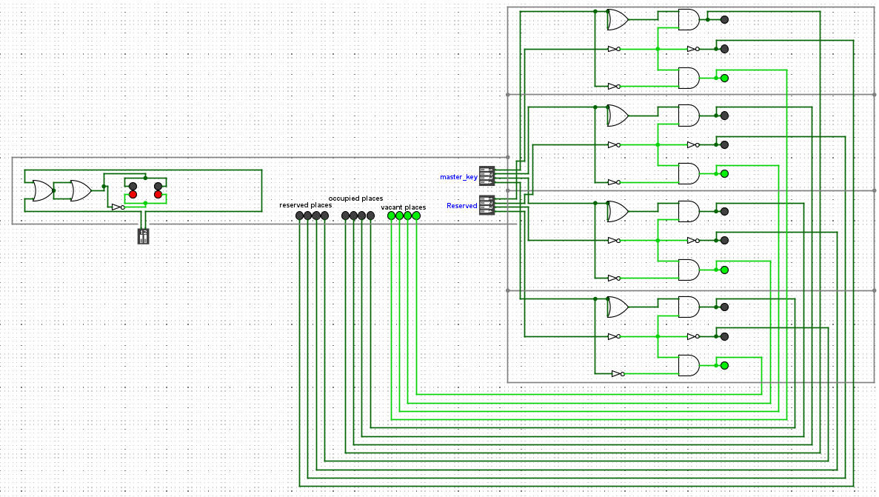
System Architecture Documentation

Slide 12
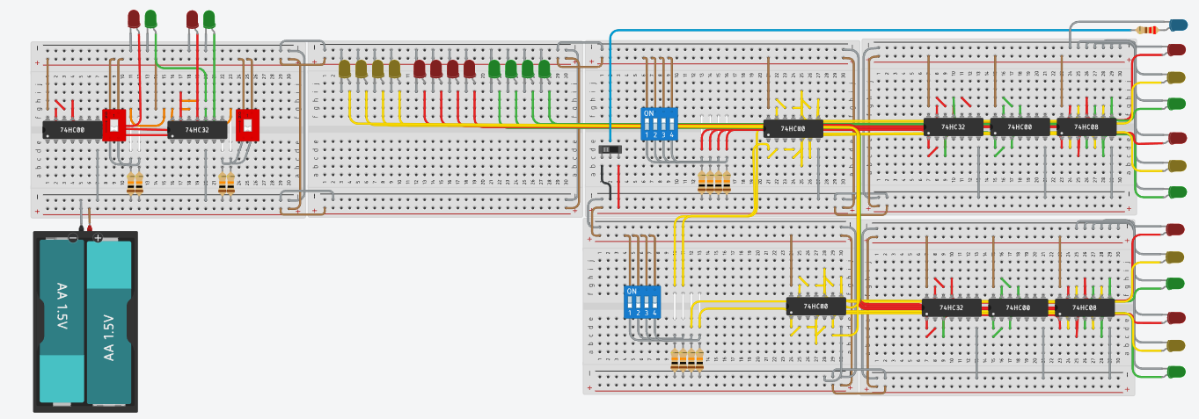
System Architecture Documentation

Slide 13
System Architecture Documentation

Slide 14
Parking Area Indicators
Parking Areas(1,2,3,4)
Car Inteface
Reservation Interface
Oppucied/Vacant Indicator Intef
Entrance and Exit Gate Inteface
Charging Station
Charging
İnterface
State Machine Diagrams

Slide 15
State Machine Diagrams
Parking Area Indicators
Parking Areas(1,2,3,4)
Car Inteface
Reservation Interface
Oppucied/Vacant Indicator Intef
Entrance and Exit Gate Inteface
Charging Station
Charging
İnterface

Slide 16
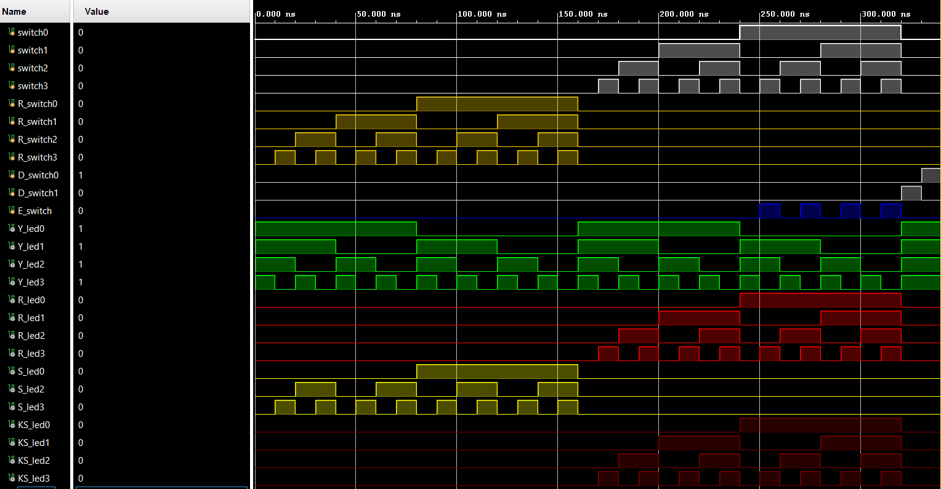
Test Cases And Simulation

Slide 17
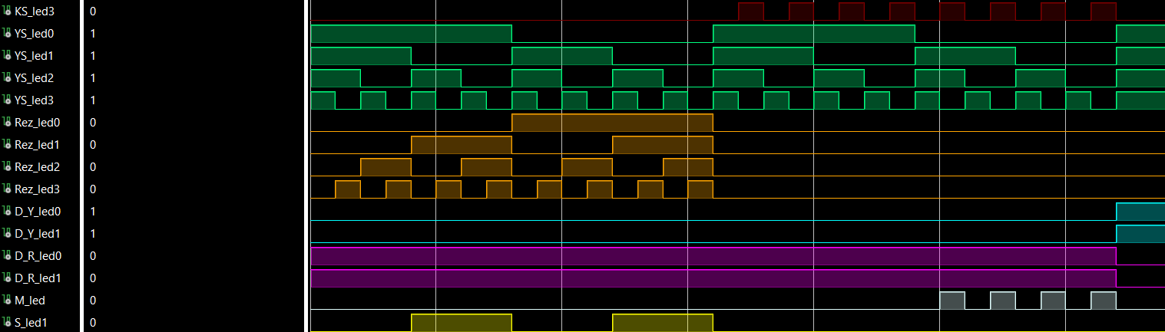
Test Cases And Simulation

Slide 18
Test Cases And Simulation

Slide 19
User Interface Documentation

Slide 20
